Slide 1
Systems Engineering and Sustainability in Commercial Vehicle Technology
Subtopic: Integration of Intelligent Transportation Systems for Optimizing Sustainability and Efficiency in Commercial Vehicle Operations
Sarvesh Telang
31.01.2024, Kaiserslautern

Slide 2
AGENDA
Integration of Intelligent Transportation Systems for Optimizing Sustainability and Efficiency in Commercial Vehicle Operations
Introduction to Intelligent Transportation Systems and ITS/CVO
Intelligent Infrastructure and Vehicle Systems
Evaluation of the Impacts of ITS Technologies on Safety and Sustainability
Challenges and Future Scope

Slide 3

Introduction to Intelligent Transportation Systems and ITS/CVO
Systems Engineering for ITS Projects
Systems that integrate information processing and communication technologies with Transportation Infrastructure, Vehicles, and Users
Systems Engineering for complex systems
Collaboration among diverse stakeholders- ERTICO (European Road Transport Telematics Implementation Coordination)
Defining roles and responsibilities of agencies
Source: Conceptual design of the ITS Project-Case in Gui’an New District, doi: 10.22617/tcs190561-2, (Nov. 2019)

Slide 4
Introduction to Intelligent Transportation Systems and ITS/CVO
ITS/CVO and ITS User services
ITS/CVO - Aims to enhance Safety, Mobility, Efficiency, Productivity, Energy, and Sustainability in CVO
Part of the National ITS program- 8 main applications and 28 sub-system user services
Travel and Traffic Management
Public Transportation Operations
Electronic Payment
Advanced Vehicle Control and Safety Systems
Emergency Management, Information Management
Maintenance and Construction Management
Commercial Vehicle Operations
Commercial vehicle electronic clearance
Automated roadside safety inspection
On-board safety monitoring
Commercial vehicle administrative process
Hazardous materials incident response
Freight mobility
Source: The opportunities and challenges of applying intelligent transport systems (May 2017)

Slide 5
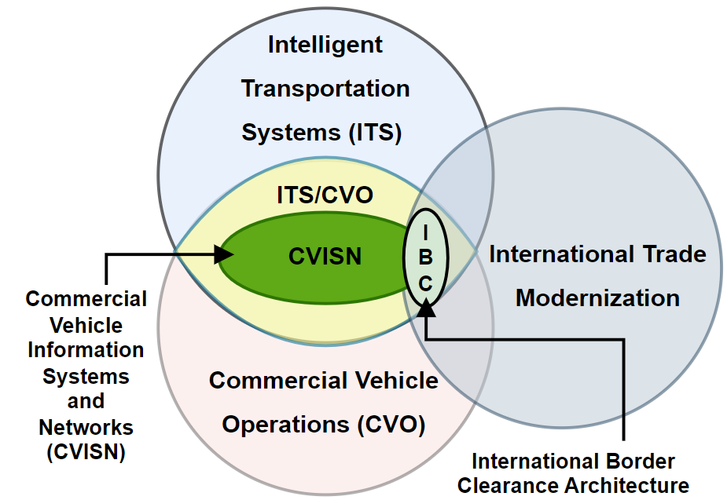
Introduction to Intelligent Transportation Systems and ITS/CVO
ITS/CVO and ITS User services
ITS/CVO - Aims to enhance Safety, Mobility, Efficiency, Productivity, Energy, and Sustainability in CVO
Part of the National ITS program- 8 main applications and 28 sub-system user services
CVISN – Exchange of information and conducting business transactions electronically
Travel and Traffic Management
Public Transportation Operations
Electronic Payment
Advanced Vehicle Control and Safety Systems
Emergency Management, Information Management
Maintenance and Construction Management
Commercial Vehicle Operations
Commercial vehicle electronic clearance
Automated roadside safety inspection
On-board safety monitoring
Commercial vehicle administrative process
Hazardous materials incident response
Freight mobility
Source: The opportunities and challenges of applying intelligent transport systems (May 2017)

Slide 6
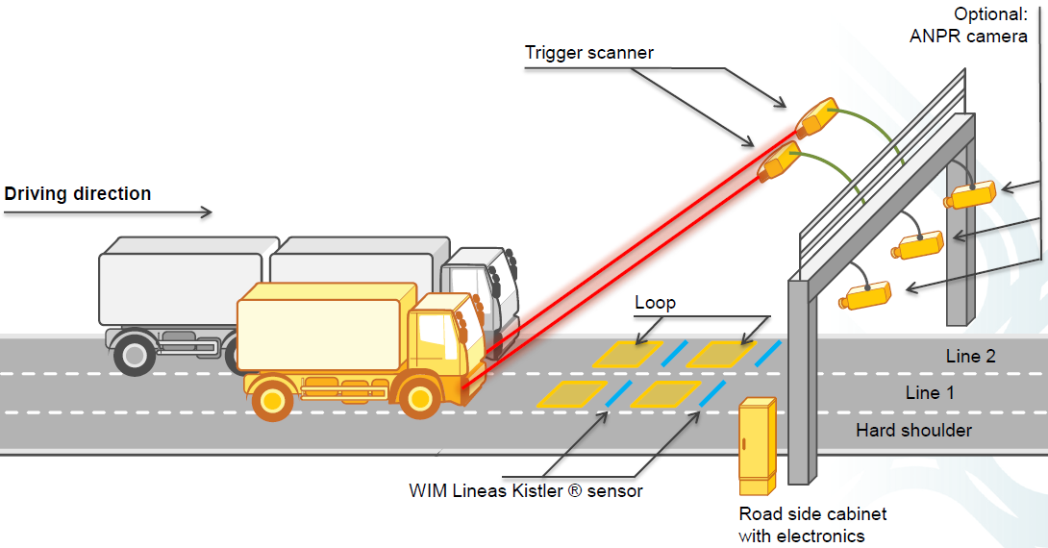
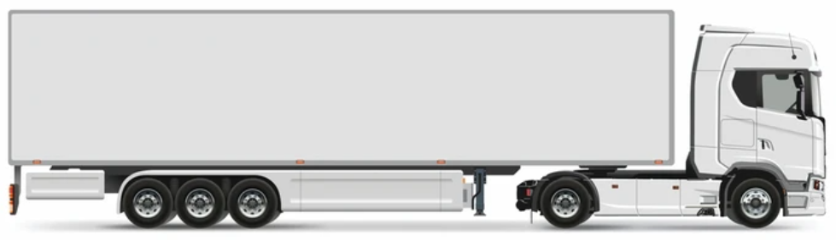
Intelligent Infrastructure and Vehicle Systems
ITS/CVO Technologies
Intelligent Infrastructure Systems
Intelligent Vehicle Systems
Co-operative ITS
Automatic Equipment Identification (RFID systems, barcodes)
Transponder for Automatic toll collection
Driver Drowsiness Detection
On Board
Computers
Automatic
Vehicle
Identification
(AVI tag)
WIM Sensors
Tyre Pressure Monitoring System
Electronic Scales
Source: Weigh-in-Motion (WIM) in Czech ETS, Kapsch Cz

Slide 7
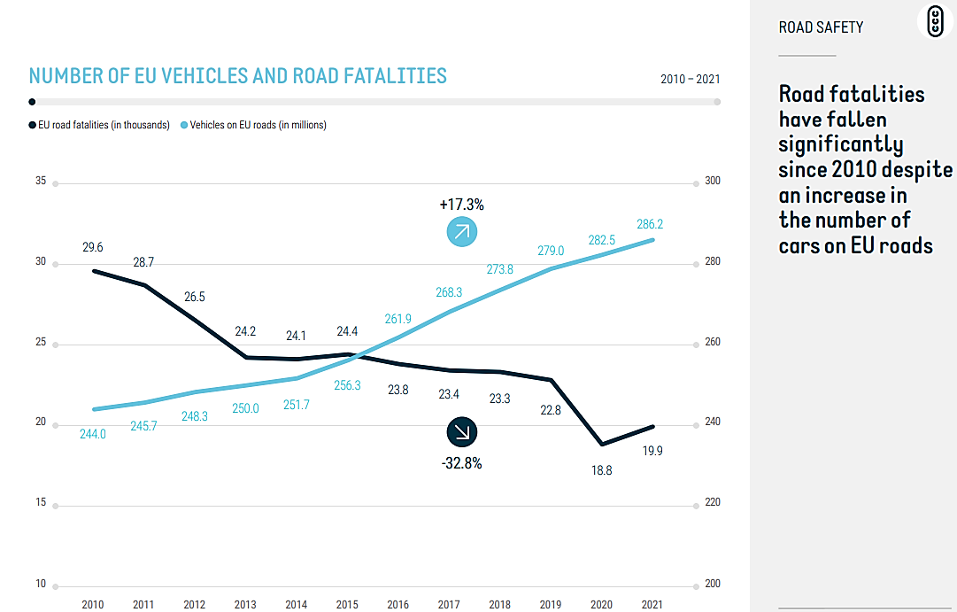
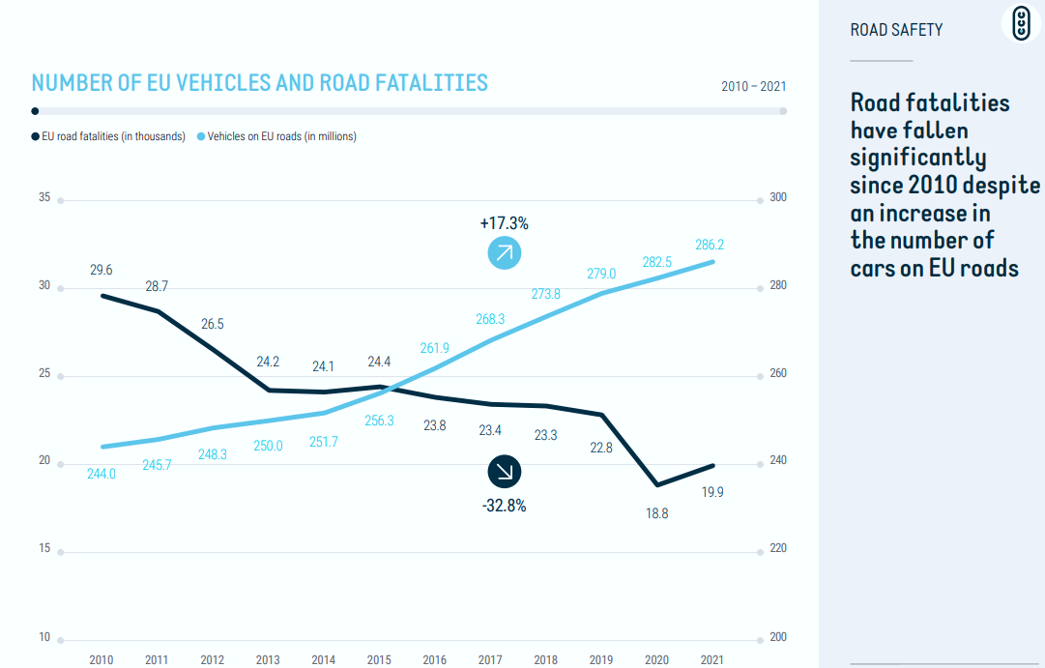
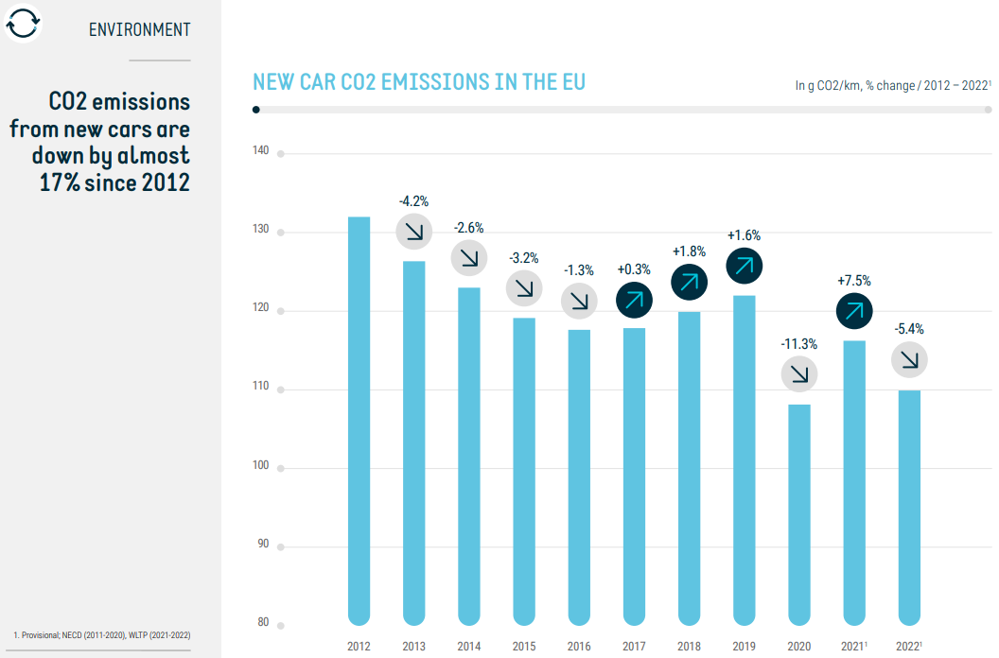
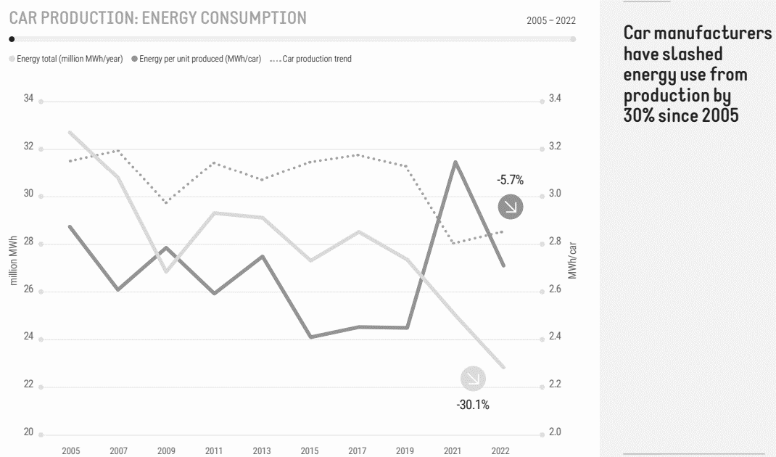

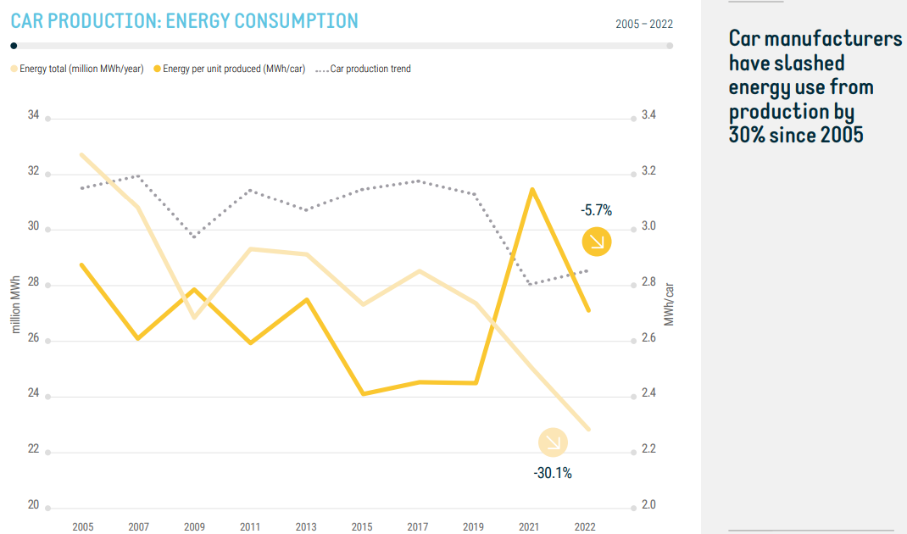
Evaluation of the Impacts of ITS Technologies on Safety & Sustainability
EU Progress in Transportation Sector after ITS Implementation (Data till 2023)
2010
Adoption of ITS Directive 2010/40/EU
2013
Release of ITS Action Plan
2016
Launch of C-ITS Deployment
2019
Implementation of C-ITS services
Oct 2023
Adoption of New ITS Directive 2023/2661
Source: ACEA-Pocket-Guide-Report 2023-2024

Slide 8
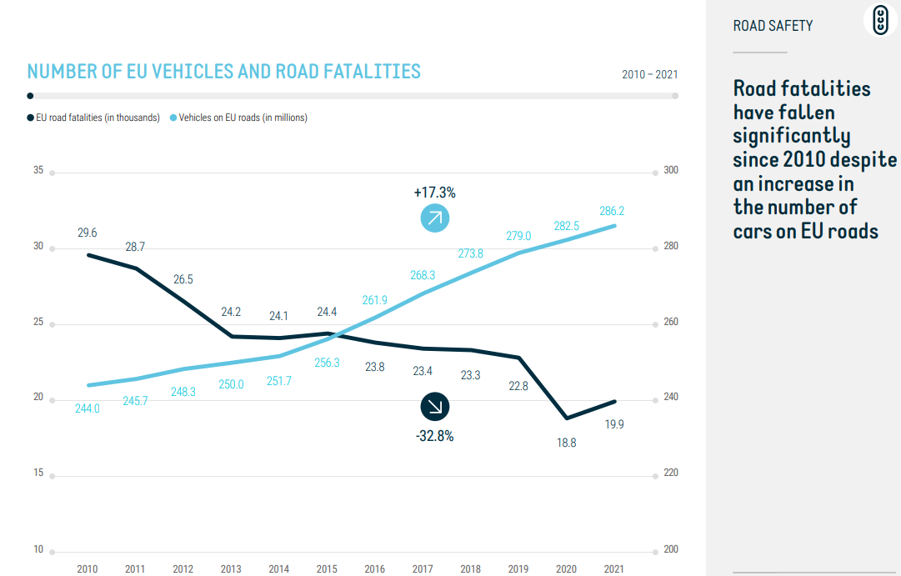
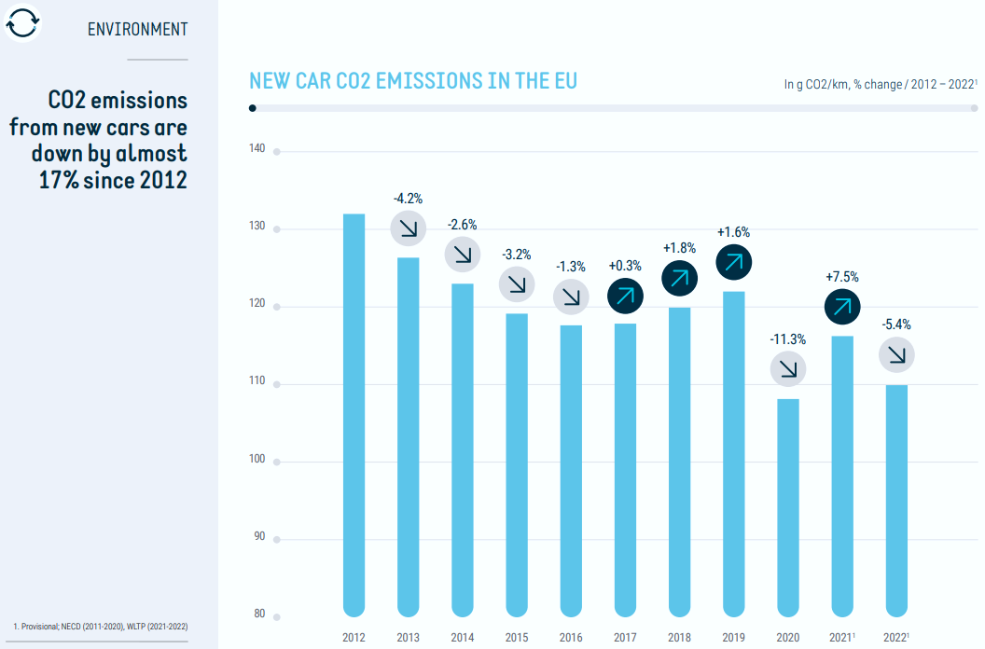
Evaluation of the Impacts of ITS Technologies on Safety & Sustainability
EU Progress in Transportation Sector after ITS Implementation (Data till 2023)
2010
Adoption of ITS Directive 2010/40/EU
2013
Release of ITS Action Plan
2016
Launch of C-ITS Deployment
2019
Implementation of C-ITS services
Oct 2023
Adoption of New ITS Directive 2023/2661
Source: ACEA-Pocket-Guide-Report 2023-2024

Slide 9
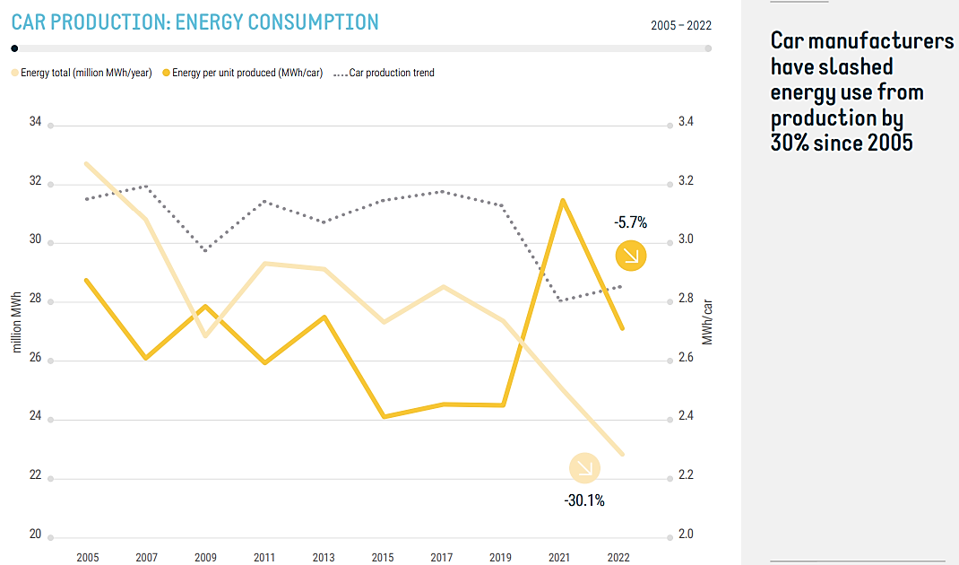
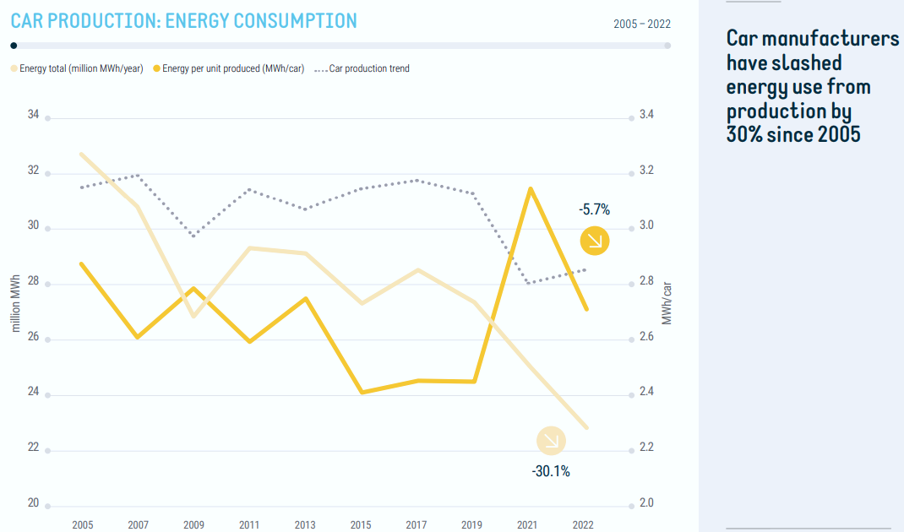
Evaluation of the Impacts of ITS Technologies on Safety & Sustainability
EU Progress in Transportation Sector after ITS Implementation (Data till 2023)
2010
Adoption of ITS Directive 2010/40/EU
2013
Release of ITS Action Plan
2016
Launch of C-ITS Deployment
2019
Implementation of C-ITS services
Oct 2023
Adoption of New ITS Directive 2023/2661
Source: ACEA-Pocket-Guide-Report 2023-2024

Slide 10
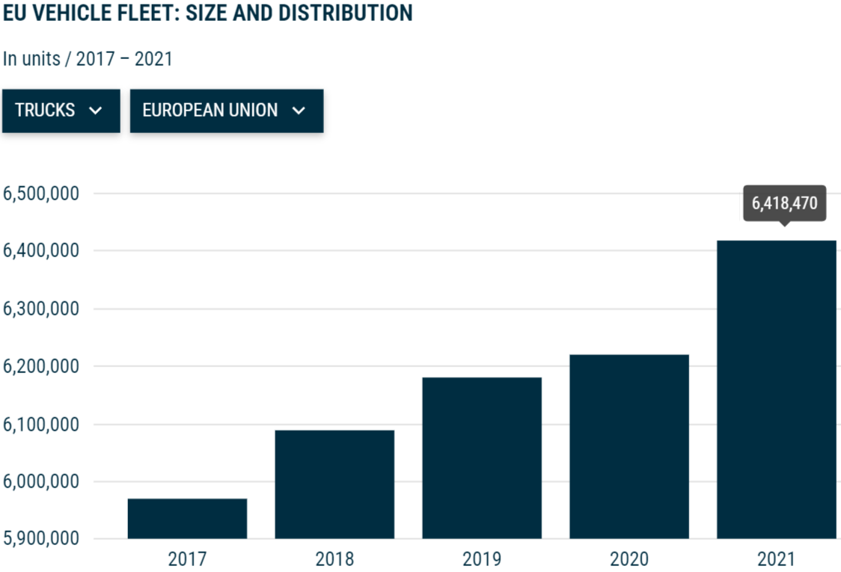
Challenges and Future Scope
Challenges
15% Increase in Traffic Congestion due to Urbanization
Costs nearly 100 billion EUR, or 1 % of the EU’s GDP
96.4% trucks of EU - Diesel-powered
Future Scope
Effective deployment of C-ITS projects with 5G
and V2X Communication
Interoperability with EVs and Autonomous Vehicles
Over 6.4 million heavy commercial vehicles
3.2%
Source: ACEA Vehicles in Use Report 2023, INRIX Traffic congestion report 2023

Slide 11




Conclusion
Indispensable for a sustainable future in commercial vehicle technology
RE: Alignment with Overall System Goals
GSCM: Optimization of Entire Product Lifecycle with efficient Design, Sourcing, Manufacturing, and Distribution
3D Printing: Cost-effective, Light weight solutions with customized component production
ITS/CVO: Optimized Safety, Traffic flow, Reduced congestion, enhanced mobility and sustainability
Requirements Engineering
Green Supply Chain Management
Holistic Systems Engineering
3D Printing technology
Intelligent Transportation Systems

